Slide 1


at
[Name of School]
Helping every young person live a life that
moves them

Slide 2
We want you to enjoy taking part in lots of different activities in and out of school

Slide 3

Why?
Taking part in different activities…
helps you discover what you enjoy
helps you develop different skills
helps you meet and interact with different people
helps you organise your time better
helps you communicate better
helps you think about how you feel
helps you feel part of your community
helps your physical and mental health

Slide 4





What is miMove?
An app for you - a place where you can keep a record and reflect upon all the activities you do
This information is then shared with us
We want to celebrate your efforts, support you if needed, and make sure you are having positive experiences

Slide 5







What is success?
Taking part in different activities (in & out of school)
Trying new activities
Overcoming challenges to take part in activity
Reflecting on how an activity makes you feel
Encouraging others
Committing to activities for a period of time (without giving up)
Taking part in activities as a regular part of your week

Slide 6

Who will see your data?
Your form tutor, HOY & teachers
Your miFriends
NOBODY ELSE

Slide 7

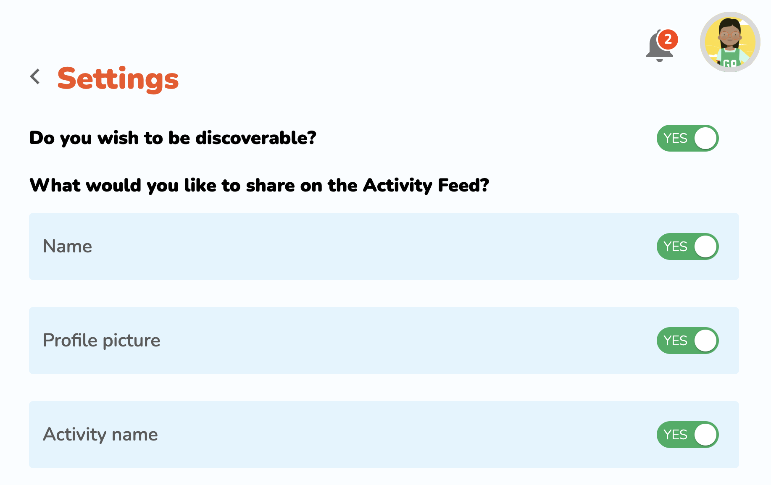
Safe connectivity
You control what your miFriends see
Menu > Settings
Post your activities
Tag your miFriends
Like your friends’ posts
Collect points
Collect badges
No messaging is possible

Slide 8






miMove is NOT
A competition
A league table
A way to judge you
A fitness scheme
A tracker
This Photo by Unknown Author is licensed under CC BY-NC
Notes:
THEREFORE there is no reason to be dishonest about your activity. Integrity is important. More important to be honest than active (but it’s great to be both)

Slide 9

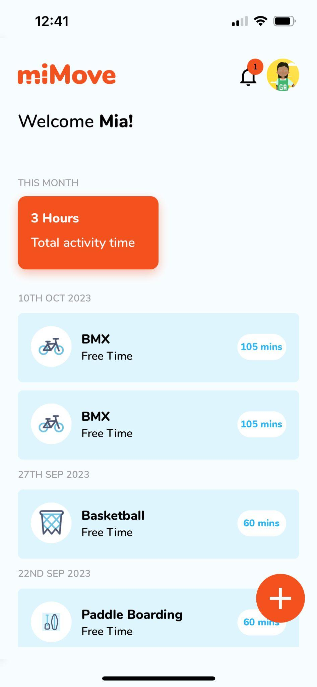
Next steps
Sign in to miMove either via mimoveapp.com > Student Sign in OR
download the miMove app to a mobile device from App Store or Google Play.
Your teacher will tell you how to sign in by:
OR
using the Username & Password
your teacher gives you
using your school Email & Password
Record all the activities you take part in
Set your own targets
Collect points & badges
Build streaks
Notes:
We will give you a Username and Temporary Password. You will be asked to change your password the first time you log in. WE DO NOT HAVE ACCESS TO YOUR NEW PASSWORD SO WRITE IT DOWN SO THAT YOU DON’T FORGET IT.
You only need to enter username and password the first time you log in.
You need to: Download and log in before [insert date]

Slide 10

Time to Launch
Record at least 2
activities on miMove
by [the end of this week]

